Slide 1
Email Classification
Department of AI & DS
Hemanth Jasti

Slide 2
Contents Of Presentation:
Abstract
Introduction
Code snippet
Conclusion

Slide 3
Abstract:
This project aims to enhance cybersecurity by utilizing Natural Language Processing (NLP) to classify emails for phishing detection, addressing the growing threat of fraudulent activities. Leveraging machine learning and deep learning, it seeks to differentiate between phishing and legitimate emails, with a focus on accuracy, precision, recall, and F1-score metrics. By deploying a real-time classification model with provisions for monitoring and retraining, it aims to fortify defenses against phishing attacks, ultimately contributing to a more secure digital landscape.

Slide 4
Introduction:
The introduction to email classification is a crucial aspect of cybersecurity, particularly in combating phishing attacks, which are sophisticated social engineering tactics used to deceive individuals into divulging sensitive information. Phishing emails often impersonate legitimate entities like well-known companies, leading recipients to fraudulent websites where personal data is compromised.
With approximately 269 billion emails sent daily and an estimated 135 million attempted phishing attacks each day, the financial impact of phishing is substantial. The prevalence of phishing attacks underscores the importance of robust email classification techniques using machine learning and deep learning models to effectively distinguish between phishing and regular emails.

Slide 5
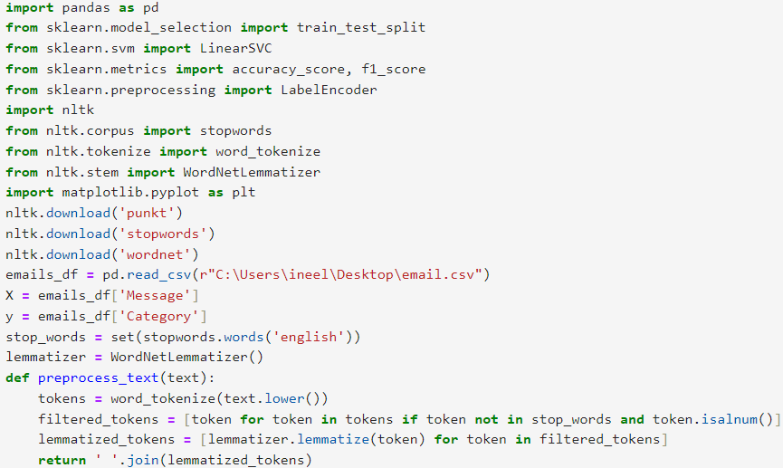
SVM:

Slide 6
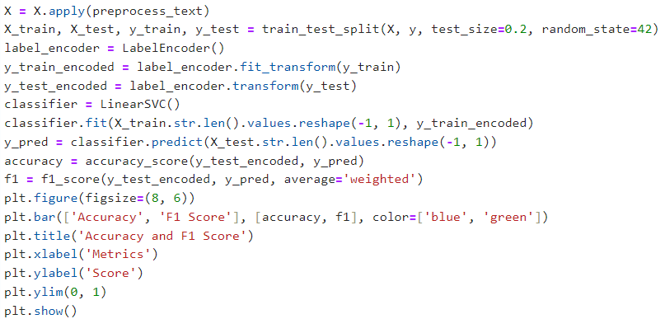

Slide 7
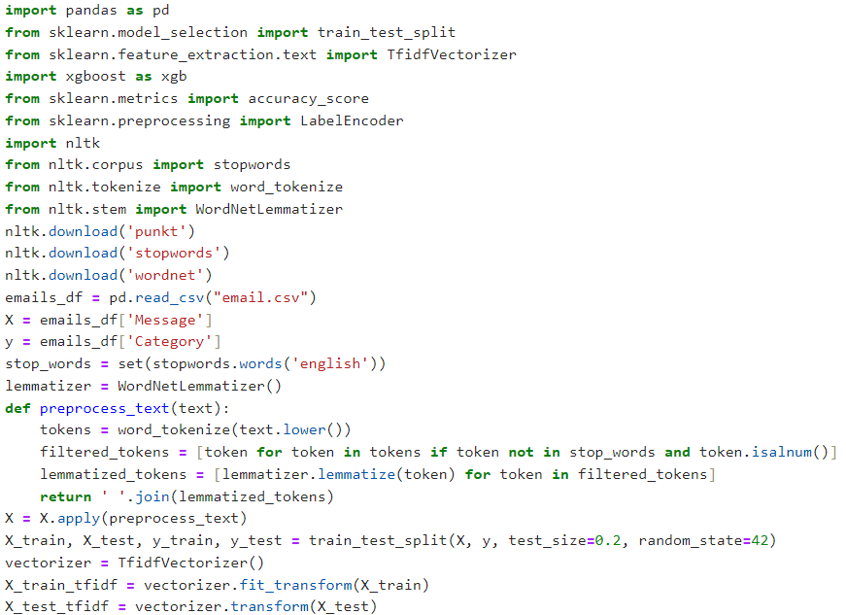
Creating a text file:

Slide 8
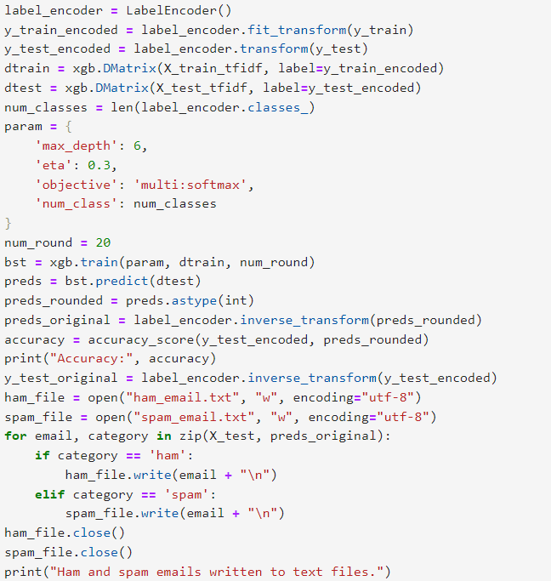

Slide 9
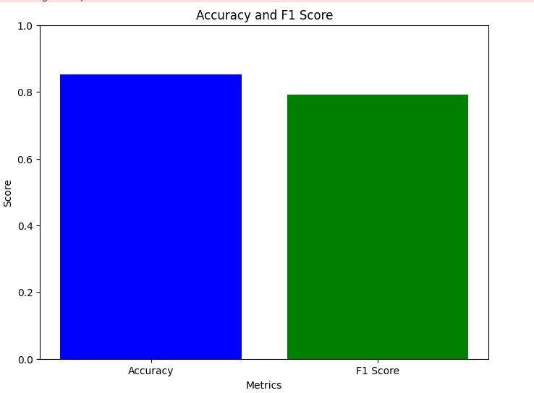
conclusion:
SVM

Slide 10
We have performed this spam and ham classification with different algorithms using the same ‘email’ dataset and observed the accuracy scores and F1 scores of them.
Combining algorithms might also enhance the model's robustness to variability in the dataset. By aggregating their predictions, the new algorithm can produce more stable and consistent results across different scenarios.
The combination of algorithms could optimize various performance metrics, such as accuracy and F1 score. While SVM may excel in certain aspects, the combined algorithm might strike a better balance between precision and recall, leading to improved overall effectiveness in spam and ham classification tasks.
From the above bar chart you can see the difference of scores from the combination of two algorithms and SVM algorithm.

Slide 11
THANK YOU

